Slide 1
Traffic Signs Detection
Object Detection using MR-CNN Model

Slide 2
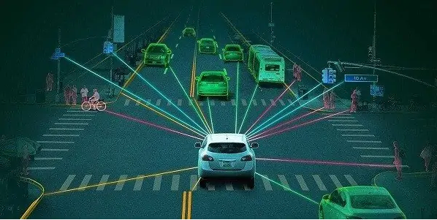
The Business Problem
Self Driven car can prevent :
94% of genuine accidents are because of human error
Total economic cost of $242 billion (by NHTSA 2010) :
Total property damage costs - $76.1 billion.
Lost working productivity - $57.6 billion.
Present and future medical costs due to injuries - $23.4 billion

Slide 3
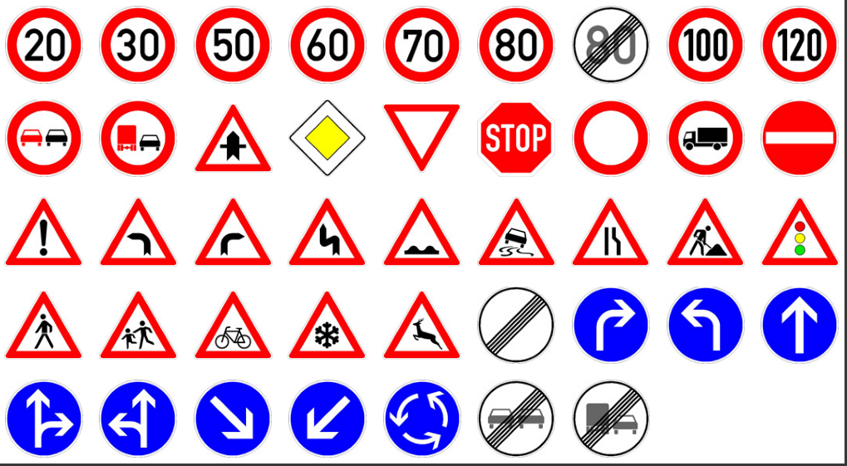
The Data
1,213 instances on 900 Images - 600 for training , 300 for test.
43 signs in 8 sub category (usually by shape & color).
Text file contain the class and truth -ground coordinates of each traffic sign in every image.

Slide 4
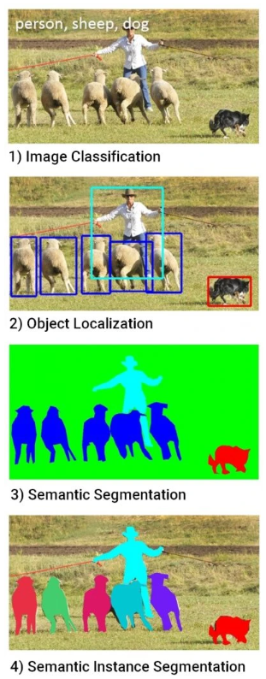
Object Recognition
1.Image Classification - What is in the image ?
2.Object Localization - where are the objects in the image ?
3. Object Detection - What and where are the objects in the image ?
Pixel level Segmentation
Semantic Segmentation Predicts a class label for each pixel in an image.
Instance Segmentation Identifies for every pixel a belonging instance of the object.
Notes:
נצטרך כנראה להפריד את Semantic Segmentation ו Instance Segmentation לעוד שני הגדרות שונות
predicts a class label for each pixel in an image

Slide 5
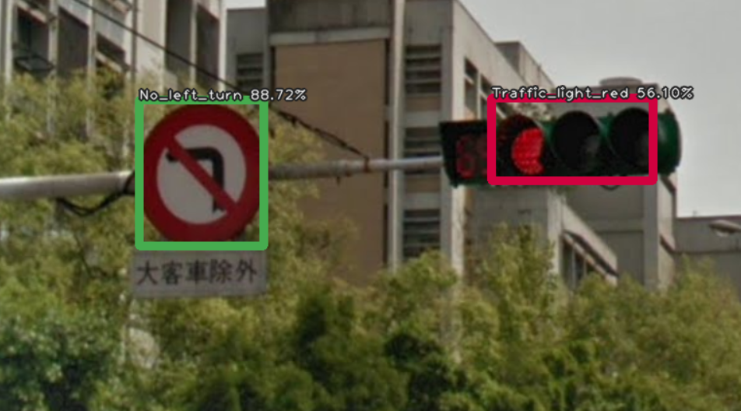
Object Detection - Popular Architectures
RCNN architectures - Region-based CNN’s
YOLO
SSD
we’re going to focus on these models.

Slide 6
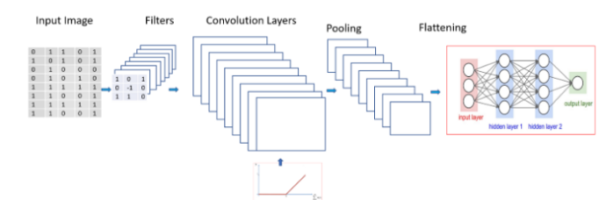
CNN
Scanning the image.
Applying filters to output feature maps ( edge detection, different shapes, bends or different colors etc).
Flattening the pooled layer applying FC for classification.
Limitations of CNN:
Don’t work well when multiple objects are in the visual field.
So, how can we identify multiple objects in an image???

Slide 7
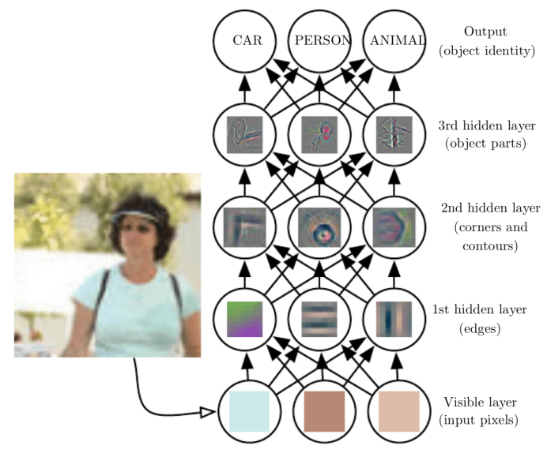
Transfer Learning(1)
Using Resnet 101 & COCO weights
Convolutional layers , Filters & polling
Detect edges, shapes, bends ,colors etc.
Feature Map \ Activation Map \ Convolved Feature
Notes:
לאיפה בפועל אנחנו מייבאים את המשקולות ? האם אנחנו צריכים שהמבנה של המודל יהייה זהה למבנה של המודל של המשקולות שאנחנו מייבאים ? לאיפה המשקולות נכנסות ? For neural networks that detect objects from an image, the earlier layers arrange low-level features into a many-dimensional space (feature detection), and the later layers classify objects according to where those features are found in that many-dimensional space (object detection).

Slide 8
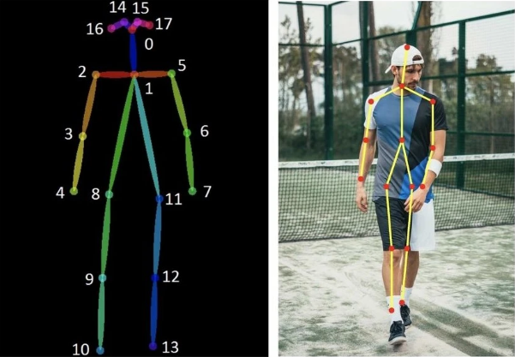
Transfer Learning(2) - COCO Dataset
Whats is MS COCO Dataset ? - Common Objects in Context
Instance annotations.
2.5 million labeled instances in 328k images.
80 things ,object categories,(person, car, chair, etc.).
91 stuff categories, (sky, street, grass, etc.) .
250’000 people with 17 different key points.
Notes:
The MS COCO dataset is a large-scale object detection, segmentation, and captioning dataset published by Microsoft. things vs stuff**
Object segmentation with detailed instance annotations
Recognition in context
Over 200’000 images of the total 330’000 images are labeled
80 object categories, the “COCO classes”, which include “things” for which individual instances may be easily labeled (person, car, chair, etc.)
91 stuff categories, where “COCO stuff” includes materials and objects with no clear boundaries (sky, street, grass, etc.) that provide significant contextual information.
5 captions per image
250’000 people with 17 different key points, popularly used for Pose Estimation

Slide 9
RCNN evolution
RCNN architectures - Region-based CNN’s
Identifying multiple objects in an image
using CNN backbone network(transfer learning weights)
“slow” RCNN
Upgrade
fast RCNN
Upgrade
faster RCNN
Extension
Mask RCNN

Slide 10
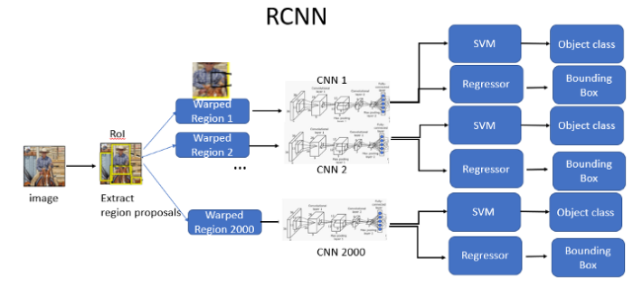
RCNN - “slow” RCNN
So how do we make the algorithm more efficient and fast?
RCNN - region proposals with convolutional neural networks
Extracting regions proposals using selective search.
Applying 3 models: CNN for feature extraction Linear SVM classifier for identifying objects Regression model for the bounding boxes
Limitations of RCNN:
RCNN is considered very slow compared to the others - due to the fact, that we repeat the process 2,000 for each image.

Slide 11
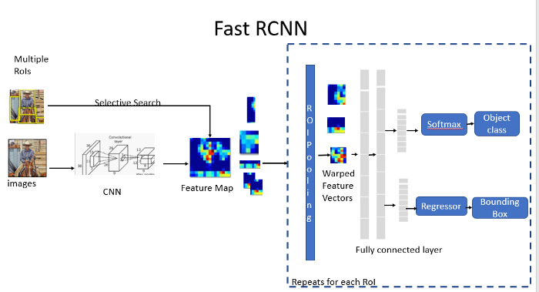
Fast RCNN
Fast R-CNN is an improved version of R-CNN architecture.
Instead of feeding each of the region proposals to the CNN, we feed the input image to the CNN only once.
Applying:
ROI pooling on selected feature map
soft max for classification
regressor for the bounding box
Does it the fastest framework?

Slide 12
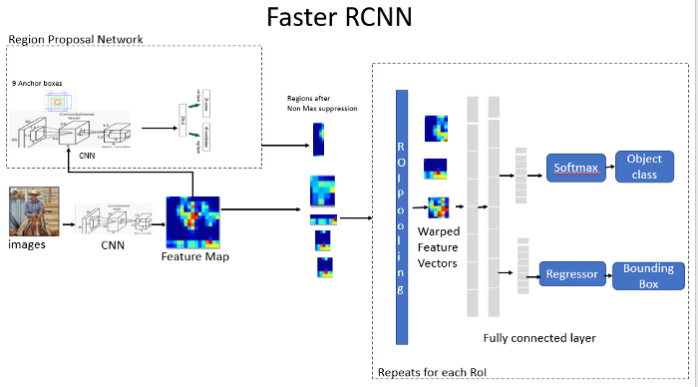
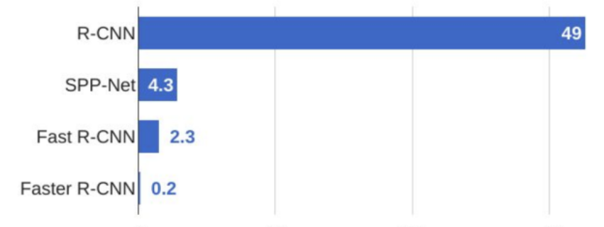
Faster RCNN
Fast RCNN + RPN = Faster RCNN
RCNNs -time speed

Slide 13
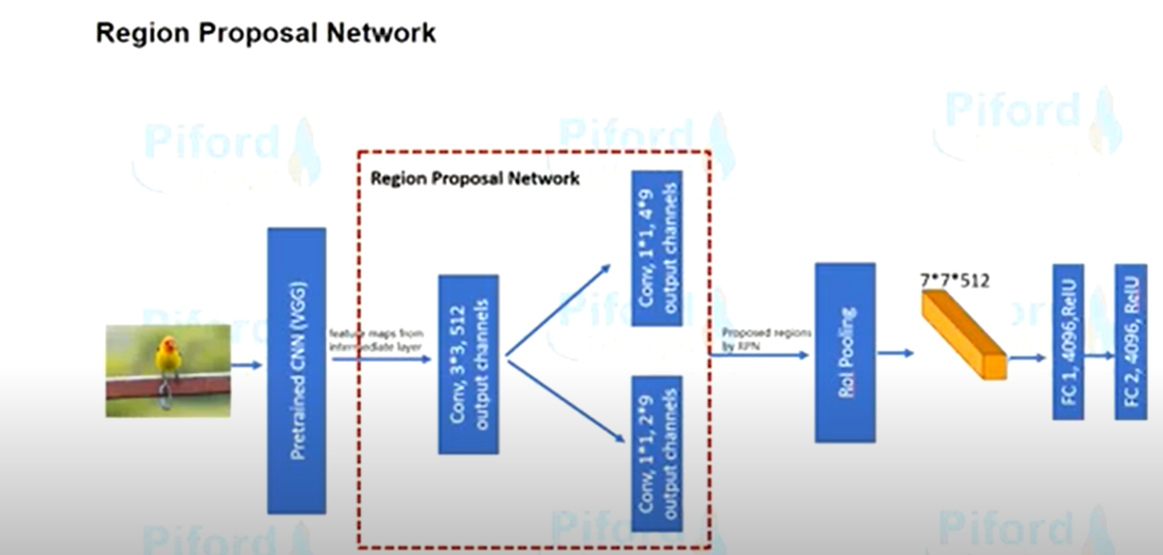
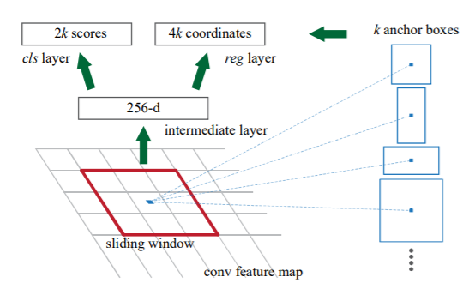
RPN - region proposal network
Anchor Box
Has a classifier and a regressor:
Classifier - binary output for the existence of an object
Regressor -bounding box

Slide 14
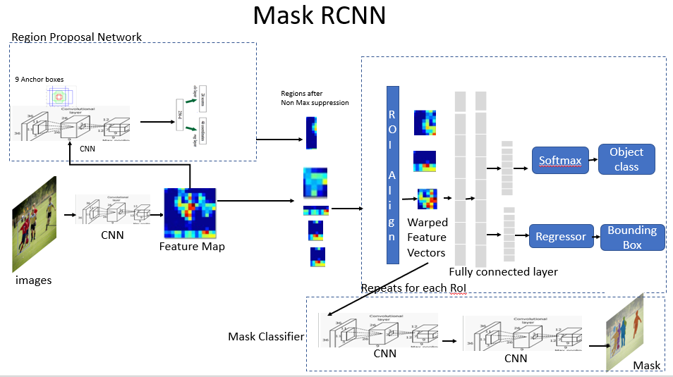
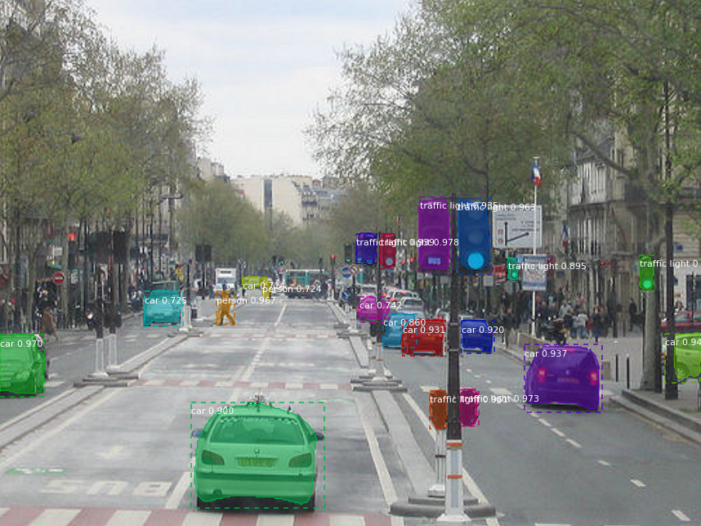
Mask RCNN
Extension of faster RCNN
In addition to the class label and bounding box coordinates for each object, will also return the object mask( segmentation mask).

Slide 15
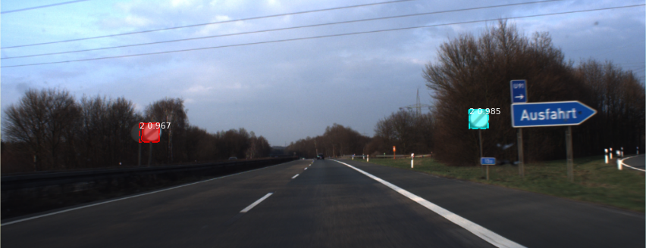
Results
Example 1

Slide 16
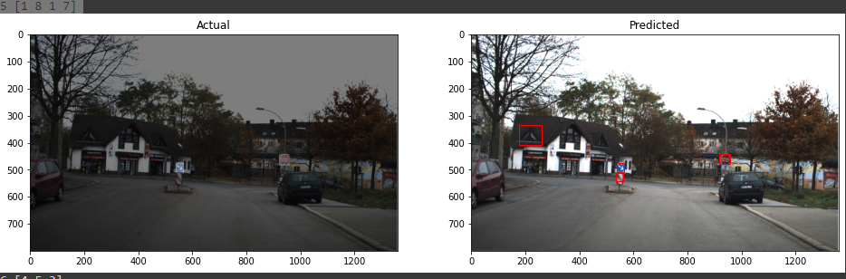
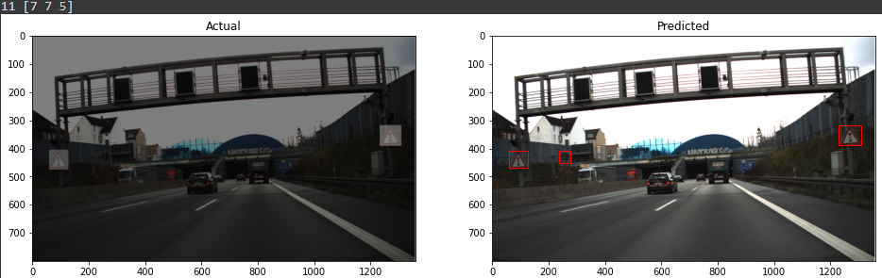
Results
Example 2

Slide 17
Model Evaluation
Iou
Precision x Recall Curve / AP / mAP

Slide 18
Model Eval - IOU
definitions:
TP - Correct detection made by the model
FP - Incorrect detection made by the model
FN - A GT missed (not detected) by the model
TN - BG region correctly not detected by the model. This metric is not used in object detection.
To define those terms, we need another helper metric called Intersection over Union (IoU)

Slide 19
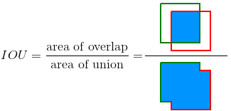
IoU
Notes:
הטווח הינו בין 0 ל-1, כאשר ב-0 אין חפיפה וב-1 ישנה התאמה מושלמת בין החיזוי לאובייקט
יש להגדיר threshold להחליט אם חיזוי הוא נכון או לא

Slide 20
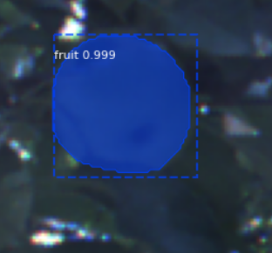
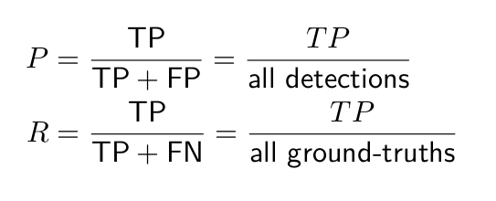
Precision x Recall Curve (PR curve)
The precision-recall (PR) curve is a plot of precision and recall at varying values of confidence.
Notes:
אם נגיד confidence threshold גבוה אנחנו נקבל R נמוך ו-P גבוה, וההיפך.

Slide 21
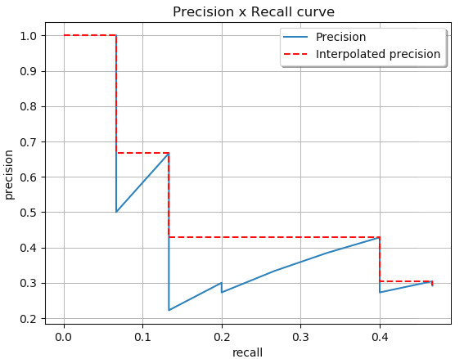
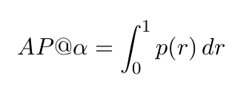
Average Precision - AP / mAP
Notes:
אם נגיד confidence threshold גבוה אנחנו נקבל R נמוך ו-P גבוה, וההיפך.

Slide 22
THE END
THE END

Slide 23
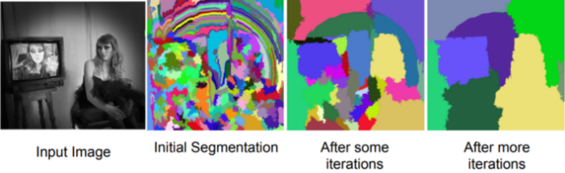
Selective search
Selective search step by step :
Step 1: Generate initial sub-segmentation.
Step 2: Recursively combine similar regions into larger ones.
From the set of regions, choose two regions that are most similar.
Combine them into a single, larger region.
Repeat until only one region remains.
Step 3: Use the generated regions to produce candidate object locations.
What forms a region in an image? Can be identified by:
Varying colors
Varying scales
Varying textures
Varying enclosures

Slide 24
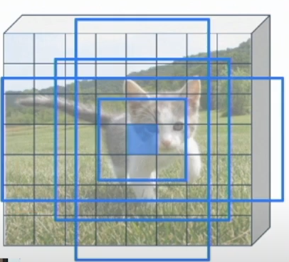
Anchor Box
what is it ? - fixed size initial boundary box guesses.
Problem : an object may have different size\ shape. solution : Use K different anchor box for each point.
how k is determined ? It is an hyperparameter of the model. by entering the number of different aspect ratios & different scales.
Notes:
Faster R-CNN
stage 1 - anchor box → region proposal (there is an object or not)
stage 2 - region proposal → object box (what class ? + BB prediction)

Slide 25
Terms
Region proposal - selective search vs Region Proposal Network (RPN)
Binary Mask \ Mask
Feature map
Iou - like jaccard similarity
Center Point + width + height → x1,y1 , x2,y2
ROI - Region of interest.
mAP - mean average precision - area under the recall - precision curve.
Non max suppression(NMS) - Drop boxes with low detection probability rate.
Anchor box - fixed size initial boundary box guesses.
Anchor Refinement.
pixel-to-pixel alignment ????
what is COCO weights ? \ Dataset ? - Common Objects in Context
region features ?
Things vs Stuff -
Things - countable entity , object that is not background.
Stuff - background , uncountable amorphous region of identical texture - (grass ,sky , mountains )
Notes:
region features always the same size even if input regions have different size

